Slide 1
Raman Groups: Please Confirm Your Availability Now Meet me in front of this room and we’ll walk over
Date/Time
24th, 1:15 pm | Charles | Nate
27th, 1:15 pm | Avi | Sarah
28th, 1:15 pm | Lylan | Owen | Chase
29th, 4:15/30pm | Mackenzie | Oliver | Garrett
If this date doesn’t work for anyone in the group, we will try the following week, but we need to know now. Text me if something changes (304-685-3329)

Slide 2
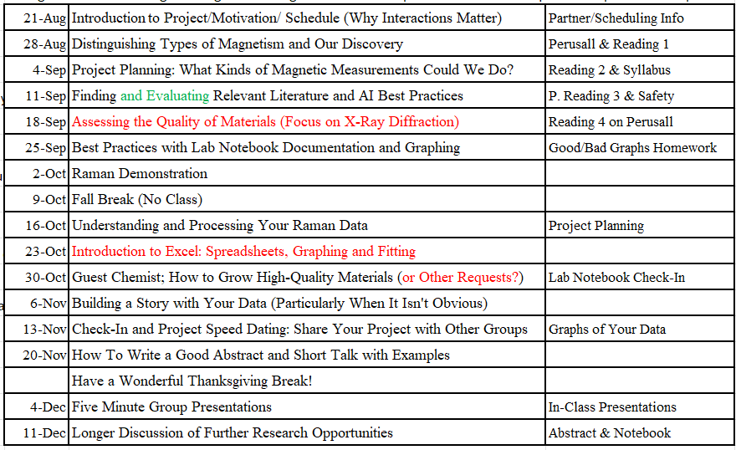
(Re)submit your project proposals Tomorrow: Last day for 1st attempt without late penalty It’s ok if you didn’t get 5/5, but improve it for full points! Final resubmission due: October 28
We are here

Slide 3
Class project check-in The hardest question on the project proposal: Why do you think your work could be important?
I’d ideally like to hear from someone that is still working on their first attempt or revision of their project proposal. Remember: You are undergrads; it is totally acceptable to not have figured this all out yet! But, we want to help push you along. To do that, we need to know where you are in the process.

Slide 4
Rest of today
Mini growth/processing lesson
Why do we get oxides lesson
Future requests?

Slide 5
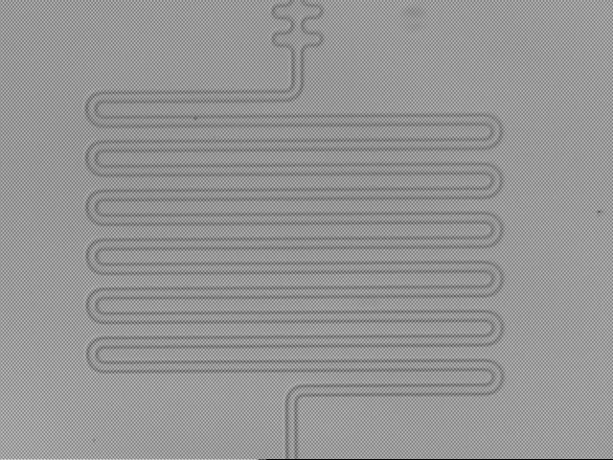
I was asked how the NASA samples are grown
The full details are complicated, but we can understand enough of it to get the main ideas.
Dark places where Nb etched away
MKID resonators:
The inner superconductor vibrates like a string at a certain frequency that gets adjusted by photon absorption
Dark places with etched

Slide 6
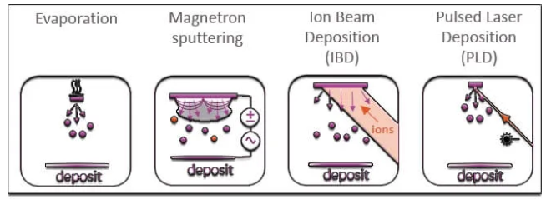
Step 2 is sputtering Nb onto silicon What is Sputtering? (One common growth method)
A few growth methods
Laser light
and more…

Slide 7
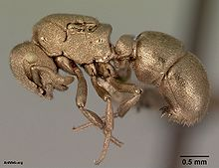
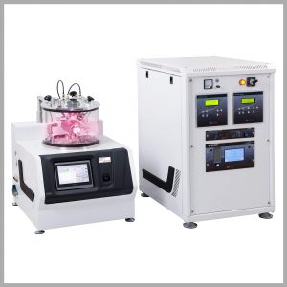
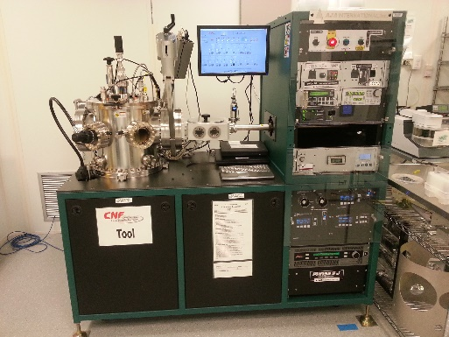
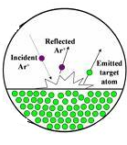
Sputtering
Sputtering is a term used to describe the mechanism in which atoms are ejected from the surface of a material when that surface is struck by sufficiency energetic particles
Discovered in 1852
Most utilized for metals
Very easy and quick
Great for uneven surfaces
Often for electron microscopy
Lower crystalline quality
Notes:
Electron microscopy doesn’t work well for charged surfaces

Slide 8
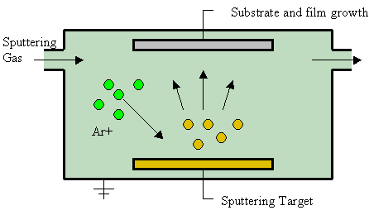
Sputtering
There are different ways to give the collision material energy. High voltage shown here (common approach).
Not always argon.
The atomic weight of the gas should be close to the atomic weight of the target.
Light elements: neon
Heavy elements: krypton or xenon.
Reactive gases can also be used.
vacuum
Notes:
Sputtered atoms ejected from the target have a wide energy distribution, typically up to tens of eV (100,000 K). The entire range from high-energy ballistic impact to low-energy thermalized motion is accessible by changing the background gas pressure.
For efficient momentum transfer, the atomic weight of the sputtering gas should be close to the atomic weight of the target, so for sputtering light elements neon is preferable, while for heavy elements krypton or xenon are used. Reactive gases can also be used to sputter compounds.

Slide 9
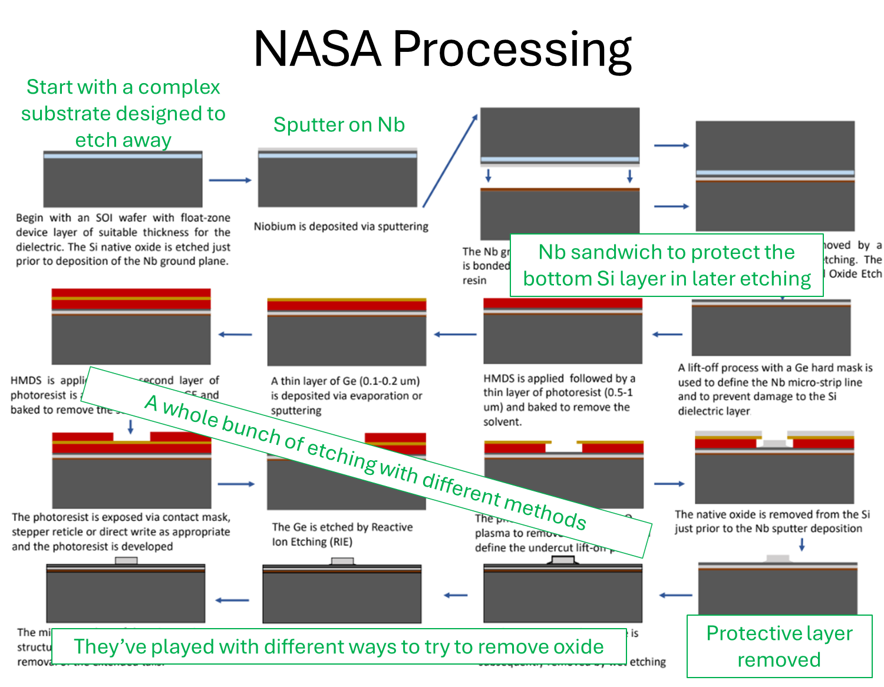

Slide 10
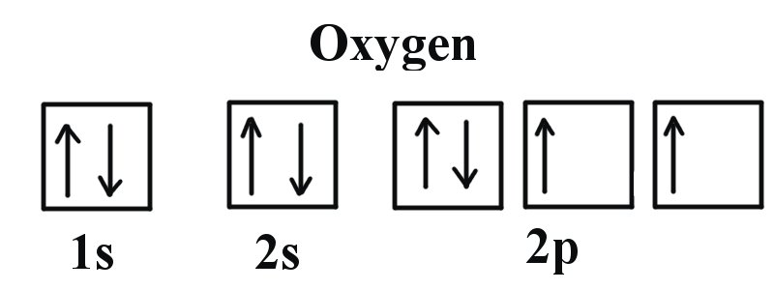

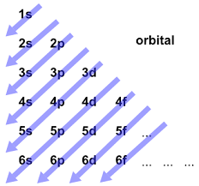
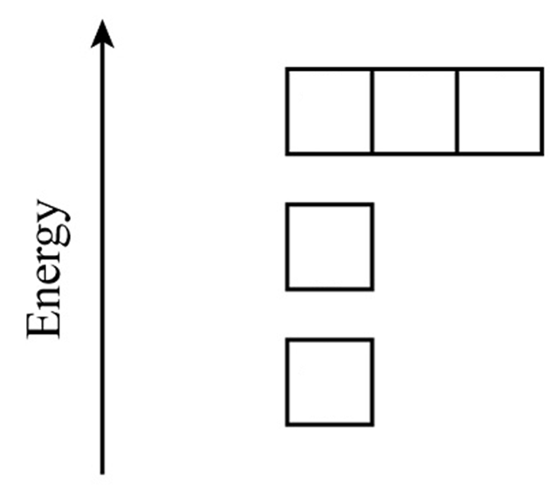


So they want Nb lines
What happens to iron over time? Why?
Let’s look at oxygen. How many electrons?
How to figure out this energy order
Notes:
It rusts.

Slide 11
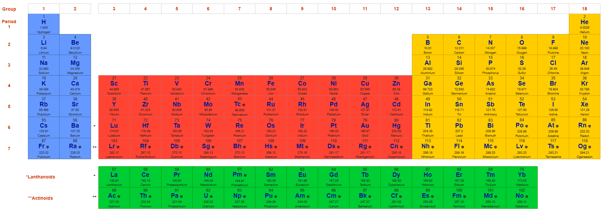
Oxygen and atoms like it like to fill up their orbitals. They will steal and/or share electrons with other atoms that are less attached to their electrons, such as metals.
How many electrons could oxygen steal from Nb?
full
Want electrons

Slide 12
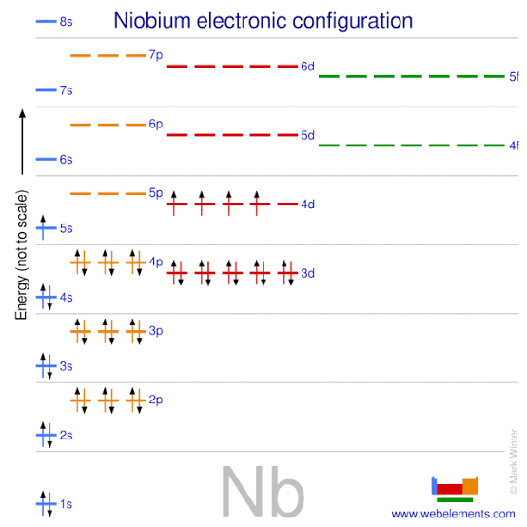
Niobium has 5 loosely attached electrons, but depending on how much oxygen there is, it may not get all of them
These are those same energy levels we saw before—just more of them

Slide 13
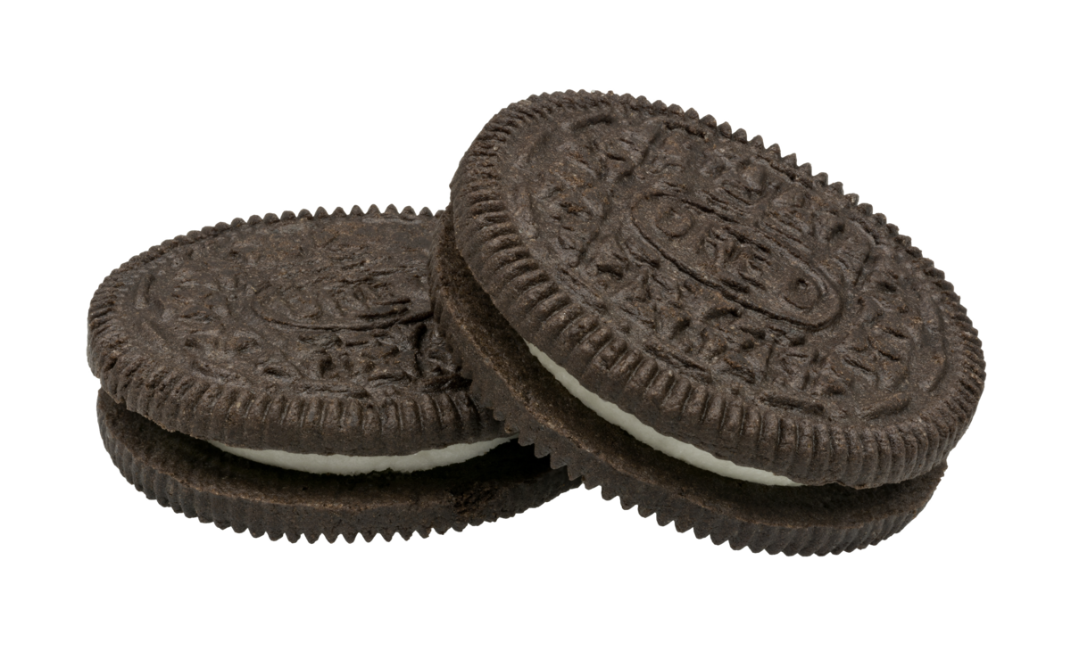
The Cookie Analogy (I just made this up.) Let’s start with two volunteers that enjoy Oreos.
Notes:
Start with two volunteers. Tell one is Nb and other is oxygen. Nb gets 5 oreos because that’s how many outer electrons can be easily removed from nb. Oxygen desperately wants 2 oreos and Nb has 5, so they give up two. What if I add another oxygen? Sorry, Nb, you’ll lose two more. What if I add another oxygen? Nb will lose all 5 and the oxygen will get as full as they can, but not completely full if there is only one Nb. If there were two Nb, how many oxygen could we support?
(Could use cups to identify the oxygens.)
Let’s switch our Nb to atoms that only have 2 electrons/oreos, though the same logic applies to Nb (just less cookies).
Now let’s start to think about structure. I need 9 volunteers. 2 oxygen and rest Nb. Given these cookies aren’t localized to stay at one person, even if the oxygen stole two cookies of the other atom, the cookies on those other same atoms can move. Oxygen is an equal opportunity stealer, it won’t just steal from one. (could discuss this crystal structure, it’s the same as the left on the next slide)
If I add in another oxygen, where would it like to go? (could do a couple of these, it would be the same as the right picture on the next slide)
This might be too much, but it’s an option: Now Holcomb could play the role of a hydrogen atom that might come by. Chem students, what do I do? Or want? I also want a cookie. Who am I going to take it from? Not oxygen; oxygen really doesn’t like its cookies taken.
For the record, I could have also done this same idea with string, but it wouldn’t have been as tasty.
The main reason full orbitals are especially stable is because:
The orbital’s charge distribution is balanced,
There’s no more room for electrons to drop in without crowding and repelling each other,
So the atom can’t lower its energy much more — it’s “comfortable.”

Slide 14
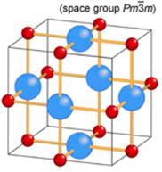
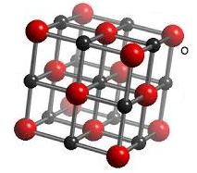
Here are two Nb oxides. Can you identify them? (Hint: Left one is easier to start with.)
The space group just tells you about the symmetry of the sample. You don’t need to understand it, but I could give a lesson on symmetry next time if it were desired.

Slide 15
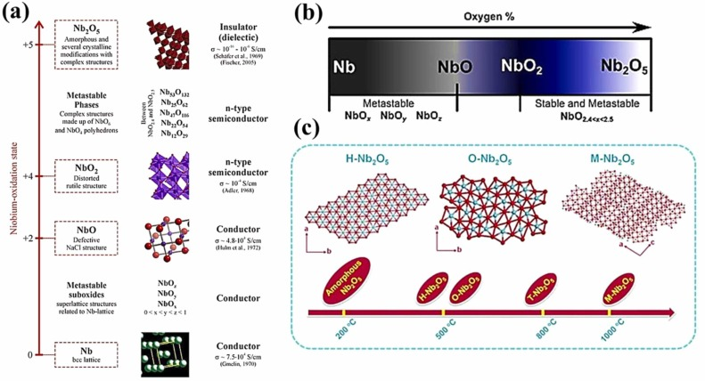
Once there are no more electrons, the oxidation can’t get any higher

Slide 16
Why might the oxides be problematic?
If oxygen reacts with the surface, it forms niobium oxides (like Nb₂O₅ or NbO₂). Those oxides are not superconducting — they’re insulators or semiconductors.
So even a very thin oxide layer can:
Change how current flows at the surface,
Disrupt the superconducting film’s boundary conditions,
Add unpredictable electrical losses.
NbO IS a superconductor but it might also interfere!

Slide 17
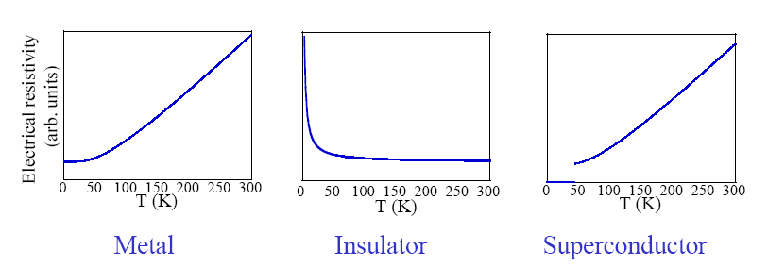
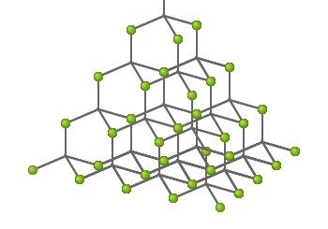
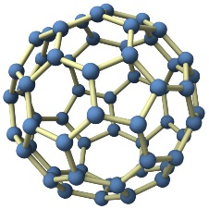
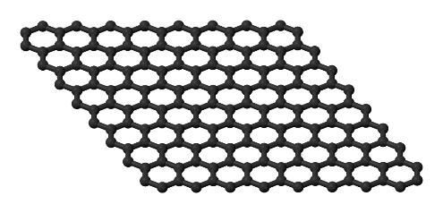
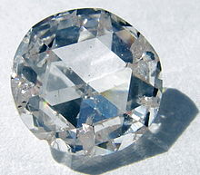
Even the same ratio of Nb and O can form in different patterns. Why might that matter?
They are all just carbon!
How can this be? After all, they each contain a system of atoms and especially electrons of similar density. Graphite is a metal, diamond is an insulator and buckminster-fullerene is a superconductor.
Recognize any?
Notes:
Let’s show simpler example.
Crystal structure can have a huge role in the material properties.

Slide 18
One group is looking at NbTiN.
Oxygen only reacts when it can get something out of it — lower energy by filling its orbitals. In NbTiN, the metals are already bonded tightly with nitrogen, so the electrons are locked up in low-energy bonds. Oxygen can’t get a better deal elsewhere, so it doesn’t bond.
full
Want electrons
Notes:
It’s not obvious just from orbital filling why this wouldn’t oxidize. Here’s the best explanation I can think of for now:
Oxygen only reacts when it can get something out of it — lower energy by filling its orbitals. In NbTiN, the metals are already bonded tightly with nitrogen, so the electrons are locked up in low-energy bonds. Oxygen can’t get a better deal elsewhere, so it walks away.

